Slide 1

IOT BASED SMART DOOR LOCKING SYSTEM BATCH:02
Under the Guidance of:- presented by:-
DR.Ramakrishnan R Chavali Rahul :191FA07072
Mr.P.Ramdoss Valeti Vishnu Vivek :201FA07053
Juhi Kumari :201FA07075

Slide 2
Contents
Abstract
Introduction
Proposed System
Hardware and Software Requirements
Block Diagram
Flow chart
Architecture
Future Work
Conclusion

Slide 3
Abstract
In recent trends, smart buildings have become the base for the Internet of Things (IoT). The usage of the internet is increased by connecting the devices in the homes to make the places more comfortable, provident, delightful, and secure. The AI-Thinker ESP32-CAM module is a low cost development board with a very small size OV2640 camera and a micro SD card slot.

Slide 4
Introduction
A main function of door is to preserve privacy and it is also the first security barrier to secure a room or area. With the numbers of crimes increasing every day, several door lock systems have been developed to allow a person to access the door. The use of IoT technology to door lock able to increase the security level of the system which this technology allows a user to monitor and control the security system via mobile. Thus, this project is suitable to implement in the office environment and to bring conveniences to themselves.

Slide 5
Existing system
For the most part, customary locks are substantial and that are not solid as they can harm basically by utilizing a few apparatuses. With these kinds of locks there is no security.

Slide 6
Proposed System
The main objective of this project is to enhance the security of the door locking system . In our proposed system we are going to use ESP32-CAM which is used take some pictures of the users when the user face is recognized it will automatically open the lock.

Slide 7
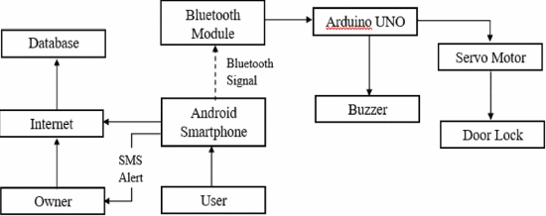
Proposed System

Slide 8
Hardware and software Requirements
Hardware Requirements:-
ESP32-CAM
Solenoid Lock
Jumpers Wires
Relay Module
FTDI Board

Slide 9
Hardware and software Requirements
Software Requirements:-
Component | Function
MIT App inventor | To create an Android app
Arduino IDE | To write and upload Arduino code
Firebase database | To store and retrieve user credentials
Wireshark | To capture network packets

Slide 10
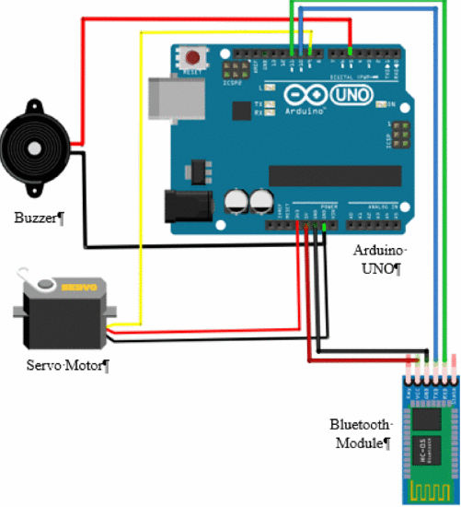
Block Diagram

Slide 11
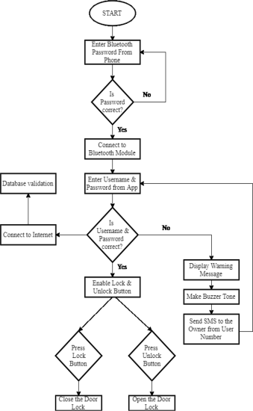
Flow Chart

Slide 12
Algorithm
Step1: The initial step is to interface every one of the parts to Arduino Uno.
Step2: The second step is to associate the Arduino Uno and associated parts to the Arduino compiler. When it is associated with the Arduino compiler begin dumping the code into Arduino Uno.

Slide 13
Algorithm
Step3: In the wake of setting up the Arduino. It is the most straightforward to utilize and there are many activities out there.
Step4: At the point when Arduino starts to stack a cluster of lines of code will show up. This will proceed until the point that the boot procedure has finished. At that point, the gadget consequently works the engine with given code and works likewise with the given secret key.

Slide 14
The Architecture
Main features of the door lock system:-
There are several features of the door lock system. It helps to lock and unlock the doors from mobile device with the help of an android application installed. It has a monitoring system, which can uniquely monitor every actions performed on the application. The system can monitor the last person who locked the door to the person who shared a specific door key with another person. With such features implanted, it enhances the security system of the place. The admins can track and monitor every single activity on-the-go.

Slide 15
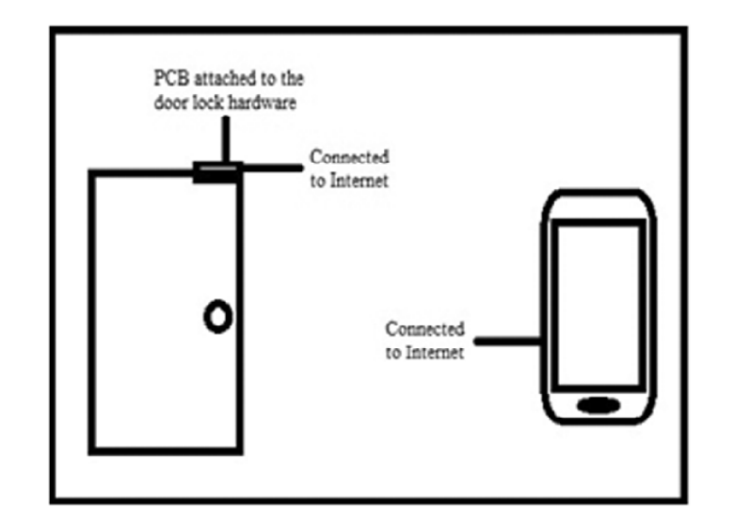
The Architecture
Structure of the door lock system:-

Slide 16
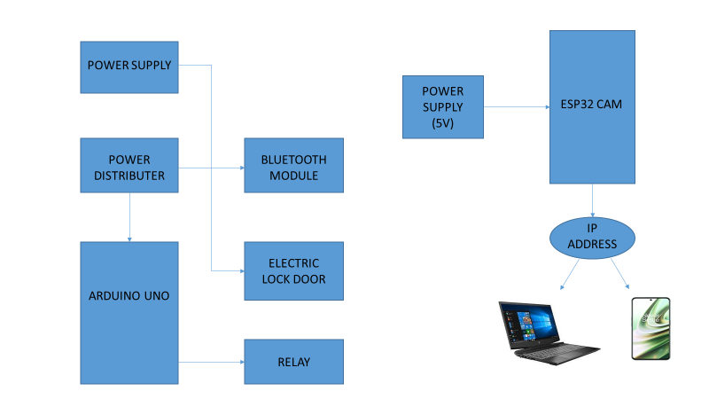
The Architecture
Smart Door Locking System
Camera Surveillance System

Slide 17
Future Work
There are several other features those will be integrated in the future aiming to solve many problems and advancements. The features to be integrated in future is an impact detection sensor, which is capable of detecting any kind of physical impact made on the door and raising an alarm on the admin’s mobile device. Users can add new doors or remove them accordingly. It eliminates the hassle of carrying several keys and more importantly the problems of losing keys.

Slide 18
Conclusion
We are going to designed an electronic door lock system that can be operated remotely by harnessing the power of IoT (Internet of things), which has better security features and is user friendly. This system has the capability to lock and unlock doors over the internet enabling keyless entry and solves the problem of losing a key. It improves user convenience by allowing the user to lock and unlock the door remotely, along with enhanced security and sharing features.

Slide 19


